Slide 1

T-SAM: Text Self-Attention Maps
Understanding Diffusion Models and Semantic Alignment
Student Name : Udit Jain
Roll No. : 24CSM1R23

Slide 2
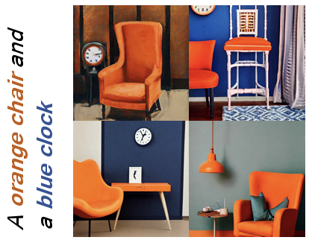
What is Text-to-Image Generation?
•
Text → Image using diffusion models.
•
Used in art, design, prototyping, automation.
•
But they still struggle with semantic alignment.
“Text-to-image diffusion models... can generate beautiful images... But even today, they often misunderstand what we are trying to describe.”

Slide 3
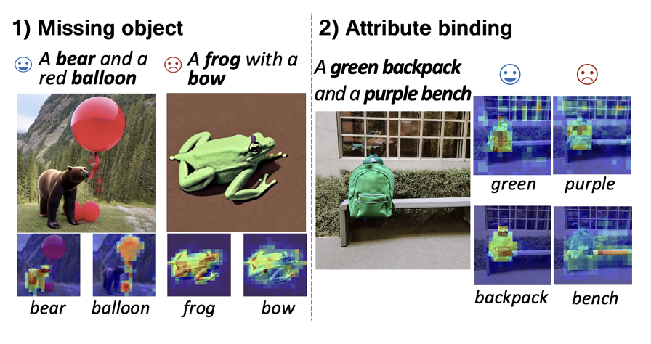
Motivation: Typical Failures
Prompt: “A black car and a white clock”
Common Errors:
•
Missing objects
•
Wrong color binding
•
Object–attribute confusion
•
Blending of multiple objects
“...the model may draw only one object, or swap the colors. This violation of meaning is called semantic misalignment.”

Slide 4
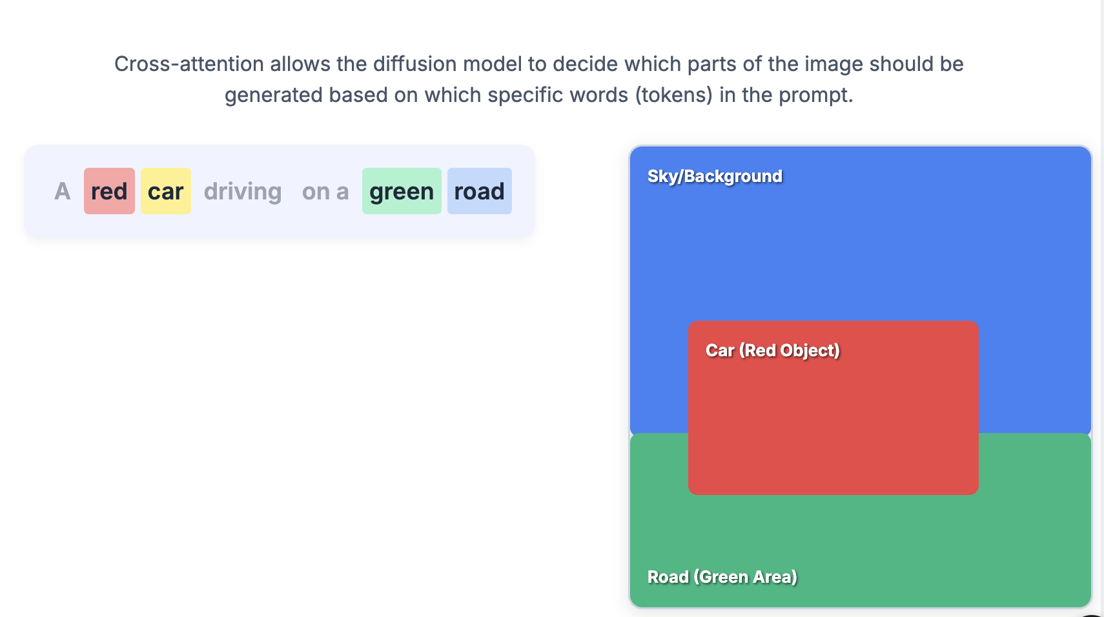
Background: Cross-Attention
•
Cross-attention links image pixels ↔ text tokens.
•
Controls what part of the image "listens to" which word.
•
Crucial for placing objects and attributes correctly.
“If cross-attention for ‘black’ overlaps with ‘clock’, the clock might incorrectly become black.”

Slide 5
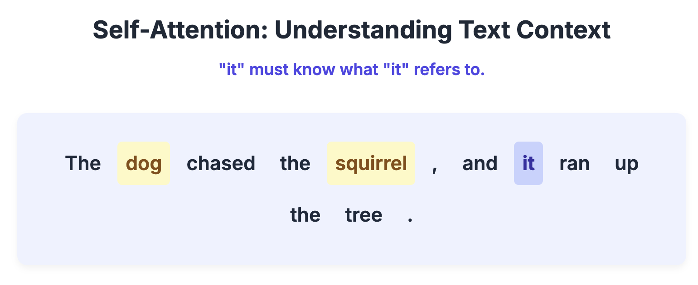
Background: Self-Attention (Text Encoder)
•
Self-attention captures word-to-word relationships.
•
E.g., “black → car”, “white → clock”.
•
This structure exists in the text encoder.
“The CLIP text encoder internally knows grammatical relations... But this information never reaches the image generator.”

Slide 6
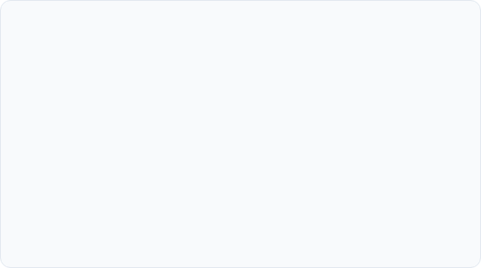

Prior Work: Attend-and-Excite
What it does
The Limitation
Forces the model to attend to all subjects during generation.
Good for “object presence,” but not fine attribute control.
Solves "catastrophic neglect" (missing objects).
“...it does not solve attribute binding — it does not know which color belongs to which object.”

Slide 7
Prior Work: Linguistic Binding (SynGen)
•
Uses an external syntax parser (like SpaCy).
•
Good, but depends heavily on parser quality.
•
Encourages correct attribute–entity pairs.
“But if the parser fails or prompt is unusual, the method breaks. Also, [it] requires extra computation...”
•
Separation of incorrect pairs.

Slide 8
Prior Work: CONFORM / Attention Regulation
Concept: Regulates attention using contrastive constraints.
Limitation 1: Needs hand-designed token grouping.
Limitation 2: Sometimes creates hard, unnatural boundaries in the generated image.
Quote: “...it still needs hand-designed token groups and can make images look unnatural.”

Slide 9
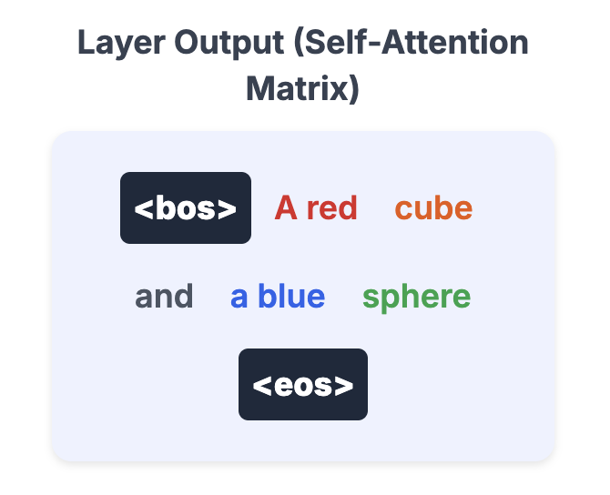
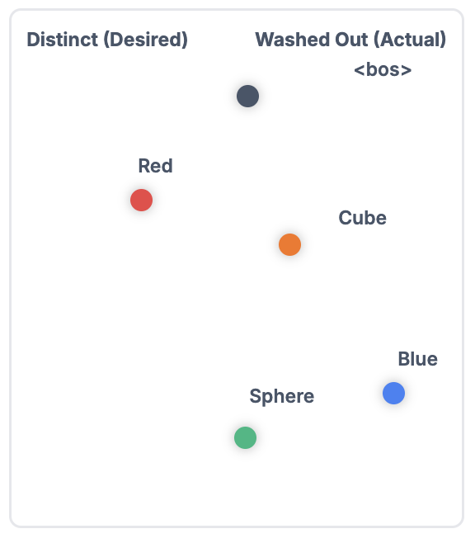
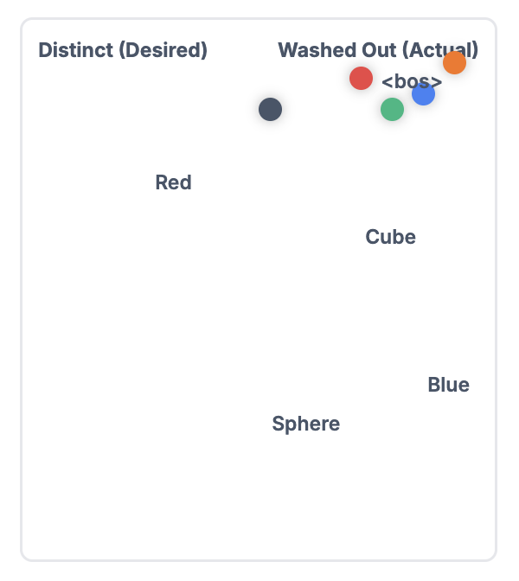
This Paper: Key Observations
“This paper shows that cross-attention blindly follows text embeddings. If embeddings for ‘black’ and ‘white’ look similar, then their attention maps overlap, causing color confusion.”
“The text encoder’s self-attention perfectly captures grammar. But due to the attention-sink effect, the final token embeddings lose these relationships, so the UNet never sees them.”
How it should be…
Final Token Embeddings

Slide 10
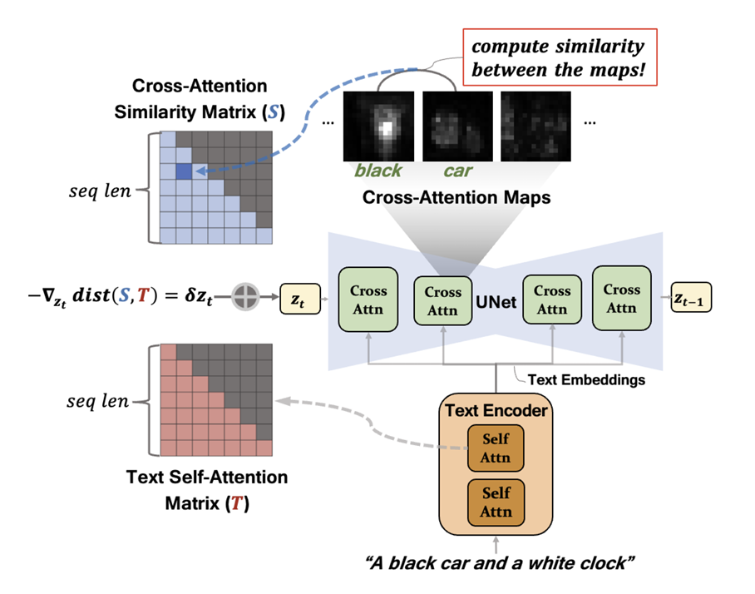
This Paper: T-SAM (Text Self-Attention Maps)
The core idea:
•
Extract text self-attention matrix T (the correct syntax).
•
Compute cross-attention similarity matrix S (image meaning).
•
Aim: Make S match T.
The idea:
Use the self-attention matrix T... and guide cross-attention S... to match it.

Slide 11
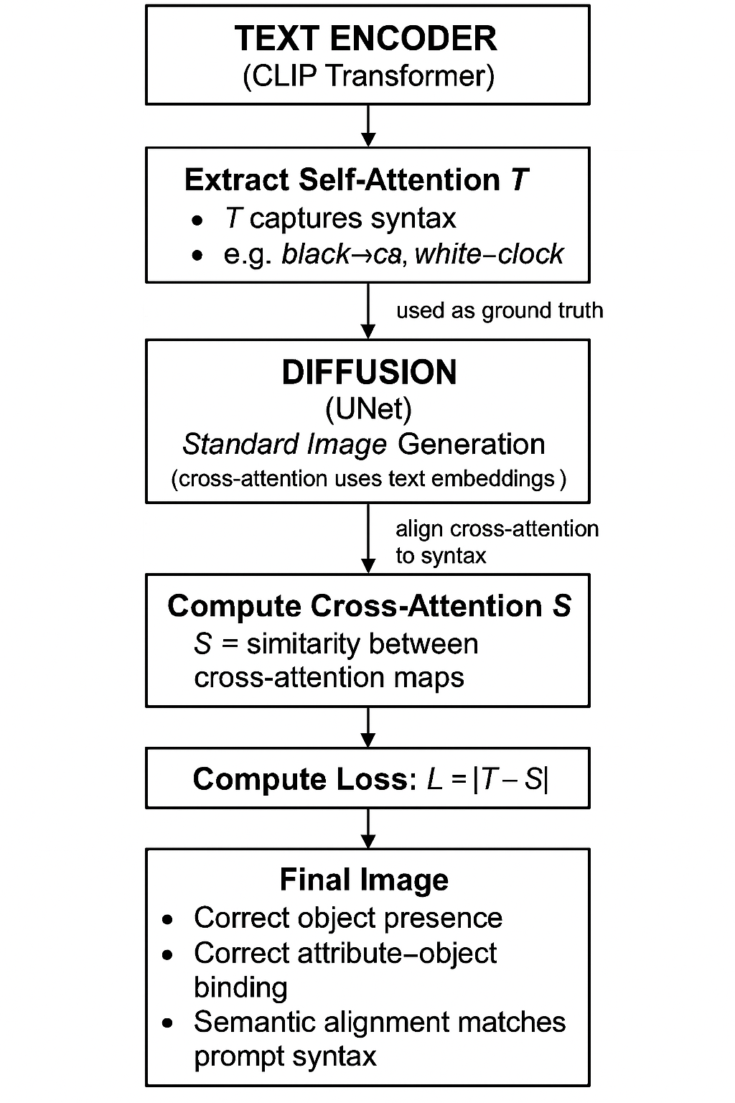
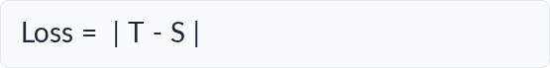
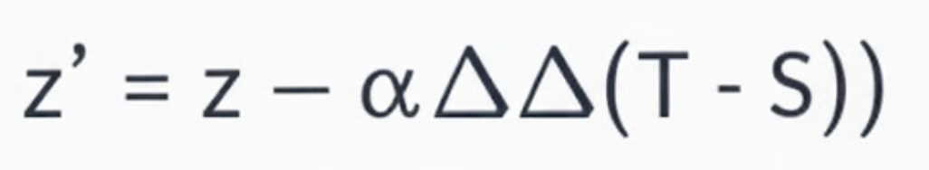
This Paper: Optimization
(Simple Loss)
A simple loss is applied:
A small gradient update nudges the latent z:
“They do not retrain the model. They simply nudge the latent at a few early denoising steps...”
Pipeline

Slide 12
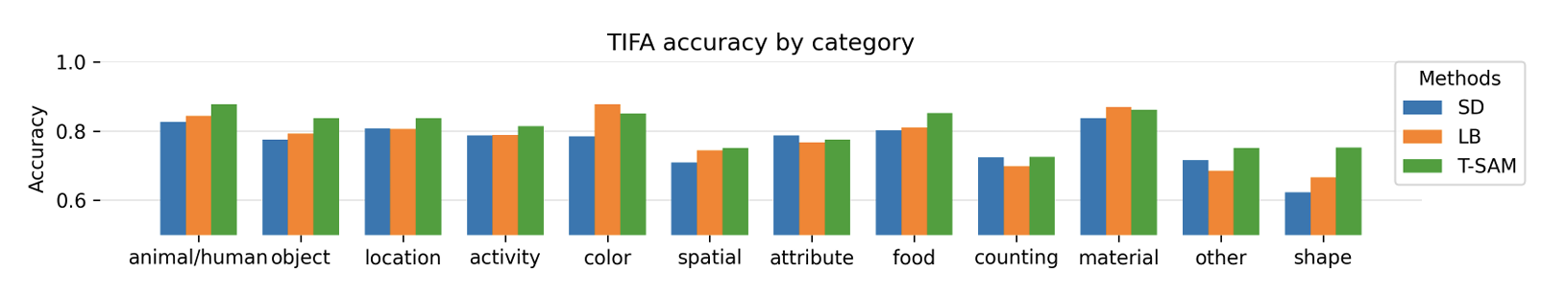
Experiments (TIFA Benchmark)
TIFA Score refers to a reference-free metric used for evaluating the faithfulness of text-to-image generation models
•
Tested on 4000+ natural language prompts.
•
T-SAM improves TIFA score significantly.
•
Handles colors, shapes, relations better than baselines.
“On the TIFA benchmark, T-SAM outperforms prior approaches across categories like color, shape, and relation understanding.”

Slide 13
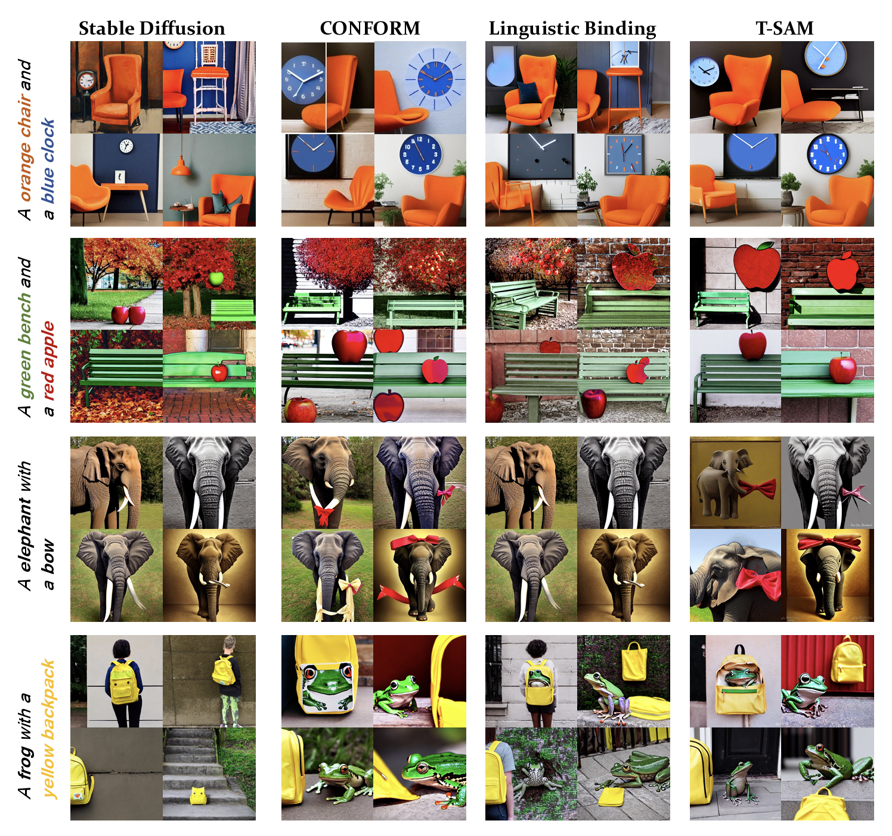
Results
T-SAM consistently improves semantic alignment, fixing wrong attribute–object bindings and reducing missing-object errors across diverse prompts.
It achieves higher TIFA scores and better CLIP-based similarity compared to Attend-and-Excite, Linguistic Binding, and CONFORM.
The generated images show clearer object separation, correct color mapping, and better adherence to textual syntax without any model retraining.

Slide 14
Limitations
Extra Computation: Extra computation during inference (optimizes latent multiple times).
Tuning: Hyperparameters (α, γ) matter and need tuning.
Scope: Only text-side syntax is considered, not image-side structure.
Length: Does not handle long, multi-sentence prompts yet.

Slide 15
Future Direction
Faster approximation of T → S alignment.
Combining image-side structure (segmentation, layout).
Multi-sentence or story-level alignment.
Quote: “The next step could be integrating visual constraints, improving efficiency, and extending syntax to long paragraph-level prompts.”

Slide 16
Summary & Evolution of Alignment
Summary
Linguistic Binding
"Simpler, cleaner, and more general... extracts syntax from the model's own self-attention."
Attribute–entity mapping via an external parser.
Attend-and-Excite
T-SAM (This Paper)
Ensures object presence. Solves missing objects.
Parser-free, self-contained syntax transfer.

Slide 17
Thank you.

